Slide 1
Family In Christ Program
The Art of Communication
Saturday, April 20th, 2013

Slide 2
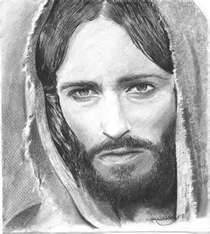
The importance of healthy family communication Basics of communication between husband and wife
The Husband
The wife

Slide 3
What is communication?
Communication
Exchange information, ideas and thoughts
Verbal communication with word or singing
Non verbal communication eyes expression, body movement.

Slide 4
Recognizing communication issues & Potential solutions
Lack of Communication is the main cause of divorce.
Communication can break down
1. finances
2. intimacy
3. parenting
4. household duties
5. Number of issues
6. Lack of listening skills.

Slide 5
Husbands and Wifes What not to do…
Do not make any decision when you are angry at each other.
Do not fight in front of your children (ex: children plays)
Do not contradict each other in front of the children
Do not shout, raising your voice will not make things happen faster.
Do not make decision when you are angry, you might regret it.

Slide 6
Husbands and Wifes What to do…
Listen
Love and respect
Care and trust
Discuss
Be a team, together you will be stronger.
Before you make a decision, pray together so the decision is the right one.
Use a low tone of voice
When you are angry you can write letters to your spouse.
Make your life together a credit experience
Make peace and sleep on it.
If you are angry find the way to cool down, take a walk, take deep breath, pray.

Slide 7
Husbands and Wifes What to do…
Make a habit to greet each other every morning and at night.
Keep each other well-informed of your plans for the day.
Use each other's name while calling out. Do not call each other mama and baba. This name are only for your children.
Make a call just to say 'hi' and keep it short.
Devote time to each other (Dr. Wang)
Work on your active listening.

Slide 8
LISTENING
Empathic Listening makes our loved ones feel worthy
In ALL our relationships greater communication brings greater results.
Parents listening to their kids helps build their self-esteem.
Husband and wife listening to each other and communicating will improve the relationship and will give a sense of security to the other spouse in the relationship.
Listening is the basis of a good communication.

Slide 9
The technique of active listening
1. Face the speaker.
2. Maintain eye contact
3. Minimize external distractions.
4. Respond appropriately
5. Focus solely on what the speaker is saying.
6. Minimize internal distractions.
7. Keep an open mind.
8. Avoid letting the speaker know how you handled a similar situation.

Slide 10
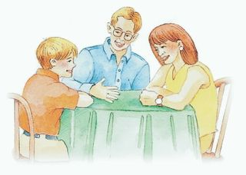
Active Listening

Slide 11
Communicating with your children
Aggressive communication
Yelling, shouting, use demeaning words
Result: feeling fearful, yelling back and ignoring their parents’ constant orders.
Ex: Daycare, kid who shout comes from family who also shout.
Passive communication mutter soft, cautious words and tones to their kids finding.
Result: Children are not disciplined and they do what pleases them. Example ( Gabriel and Raphael)

Slide 12
Communication/Rules
Communicating with kids in an assertive way is a real skill yet it shows your kids that mum and dad know what they’re going on about and to listen.
Assertive communication start with setting rules in your home.

Slide 13
Assertive communication Communicating with kids in an assertive way is a real skill yet it shows your kids that mum and dad know what they’re going on about and to listen
An assertive way of communicating
Be Firm without shouting
Be Consistent
Be Clear
Be Positive
Be Warm
Be Confident.

Slide 14
Assertive communication and Rules
Set rules. Rules that you both agree on. Rules can change as long as you have discussed it together.
Be reasonable in your rules (sleeping time)
Phrase your wording in a positive manner. (You do not understand anything etc.)
Let Your Kids Help You Write the Rules
Refer to the rules as often as you can. Ex: Going to the dollar store.
Set the consequences.

Slide 15
Set the rules in your home
Some examples:
Tell the truth.
Treat each other with respect. No yelling, no hitting no kicking no name-calling no put-downs
Respect each other’s property.
Ask permission to use something that doesn’t belong to you.
Ask permission before you go somewhere.
Put away things that you took out.
When we eat, computer, ipad or phone should be put away, this is time for the family.
You will participate in the chores of the house. Prepare a list and let each kid participate.
We will pray before we eat.
We will go to bed at a specific time. (Egyptian children do not have a curfew to sleep)

Slide 16
Some tricks on making your kid respect the rules.
Use 123 magic,
Use a timer
Give them choices that you have chosen for them. You empower them to make the decision. Ex: Cloth from night
Use prevention rather than action. Try to predict.
Sweet and candies are not a good trick (bad for their teeth and for their health and addictifs)

Slide 17
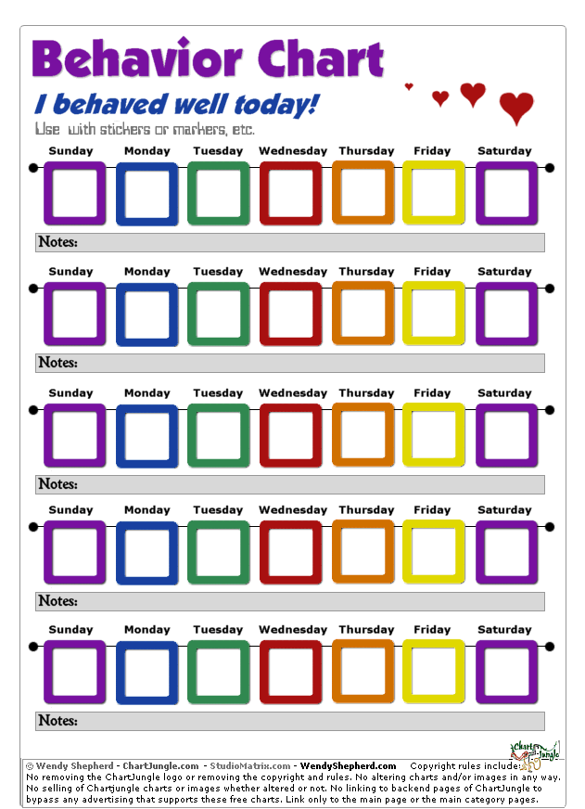
Some tricks on making your kid respect the rules
Use behavioral chart.
Put a star to every good
Behaviour

Slide 18
Consequences
Criteria to choose a consequence:
The age of the child
The preferences of the child
The rule that was broken

Slide 19
Consequences
The best consequence is the one that is significant for a child. Example:
1. TV or no TV
2. Soccer or no Soccer
Consequences if the rules are not followed.
Never break the consequences.
If using time out it is 1 min per age.
Never use Church as a punishment.
Never use Loudness and aggressive behaviour (hitting, insulting etc)

Slide 20
Self Esteem
Self-esteem is your opinion of yourself. High self esteem is a good opinion of yourself and low self esteem is a bad opinion of yourself.

Slide 21
If a Child
If a child lives with criticism, he learns to condemn. If a child lives with hostility, he learns to fight. If a child lives with ridicule, he learns to be shy. If a child lives with fear, he learns to be apprehensive. If a child lives with shame, he learns to feel guilty. If a child lives with tolerance, he learns to be patient. If a child lives with encouragement he learns to be confident. If a child lives with acceptance, he learns to love. If a child lives with recognition, he learns it is good to have a goal. If a child lives with honesty he learns what truth is. If a child lives with fairness, he learns justice. If a child lives with security, he learns to have faith in himself and those about him. If a child lives with friendliness, he learns the world is a nice place in which to live to love and be loved.

Slide 22
إذا كان طفل يعيش
إذا كان طفل يعيش مع الانتقادات، بعد أن يتعلم أن يدين. إذا كان طفل يعيش مع العداء، كان يتعلم للقتال. إذا كان طفل يعيش مع السخرية، أن يتعلم أن تكون خجولة. إذا كان طفل يعيش مع الخوف، بعد أن يتعلم أن يكون تخوف. إذا كان طفل يعيش مع العار، أن يتعلم أن تشعر بالذنب. إذا كان طفل يعيش مع التسامح، بعد أن يتعلم أن يكون المريض. إذا كان طفل يعيش مع التشجيع أن يتعلم أن يكون ثقة. إذا كان طفل يعيش مع القبول، كان يتعلم للحب. إذا كان طفل يعيش مع الاعتراف، أن يتعلم أنه لأمر جيد أن يكون هدف. إذا كان طفل يعيش مع الصدق يعلم هو ما هي الحقيقة. إذا كان طفل يعيش مع الإنصاف، أن يتعلم العدل. إذا كان طفل يعيش مع الأمن، بعد أن يتعلم أن يكون الإيمان في نفسه وتلك نبذة عنه. إذا كان طفل يعيش مع الود، أن يتعلم العالم مكان جميل للعيش إلى الحب وأحب أن يكون فيه

Slide 23
Communication
Non verbal communication
(2/3)
Vs
Verbal communication
(1/3)

Slide 24
Type of non verbal communication
Facial expressions
Body movements and posture
Gestures
Eye contact
Touch
Space
Voice

Slide 25
Tips for effective communication
Use your child’s name.
Use positive language tell them what to do not what not to do.
Try to eliminate words you use that may be ridiculing. (The words that kill)
Positive and kind words give your child more confidence, makes them feel happier.

Slide 26
Tips for effective communication
Remember to always say please and thank you to your wife/husband and kids
Connect with your child with eye contact.
When you are chatting with your kids, this shows them also what they should do.
Say your child’s name until you get their eye contact.
If you need them to do something go to them and tell them what to do. (order from another room)

Slide 27
Tips for effective communication
It is important that they give you their attention, and you should model the same behaviour for them.
Use volume appropriately
If your child yell do not yell back. Wait until he calms down. (time to relax and then he will listen, ex.)
Give your children notice.

Slide 28
Tips for effective communication
Suggest options and alternatives
Give them choices
Make it a game and competition with you. (who dresses first)
Use word like when and which rather than if
Also, try to include your child in helping you solve a problem.

Slide 29
Tips for effective communication
Keep it simple
Try to stagger your requests into small blocks.
Be perceptive to their level of interest in the conversation.
Keep away from nagging
Create a job chart.
Try to set a time where kids know what is expected. Put them on schedule.

Slide 30
Tips for effective communication
Model and expect good manners.
Children deserve the common courtesy of manners .
Be firm
Make sure that they do not play you against the other parent. Ex.
Make your requests important and speak as though you mean it.

Slide 31
Tips for effective communication
Ask open-ended questions (what, when etc.). Show interest to what they say. (Active listening)
Show that you are interested in what they have to say by using inquiry based listening.
Check for understanding (make them repeat)
Explain what you want with rather using you, use I. Ex.
Give notice
If you really cannot talk at that point, don’t pretend to be listening.

Slide 32
Tips for effective communication
Make time for one-on-one conversations .
Try not to sweat the small stuff. Choose your battle.
Evaluate the situation: accident or no accident.
Be considerate.
Don’t interrupt.

Slide 33
Tips for effective communication
Make conversation a priority with your kids.
Talk and listen
It is a two way communication.
Choose the place to do it

Slide 34
Tips for effective communication
Use
“I”
versus
“You”

Slide 35
How to encourage your children
Wow! • Way to go • Super • You're special • Outstanding • Great • Excellent • Good • Neat • Well done • Remarkable • I knew you could do it. • I'm proud of you • Fantastic • Super • Star • Nice work • Looking good • You're on top of it • Beautiful • Now you're flying!• Wonderful • You're catching on • Now you've got it • You're incredible • Bravo • You're fantastic • Hurray for you! • You're on target • You're on your way • How nice • How smart • Good job • That's incredible • Hot dog! • Dynamite • That's beautiful • You're unique • Nothing can stop you now • Good for you • I like you • You're a winner • Remarkable job • Beautiful work • Spectacular • You're darling • You're precious • Great discovery • Thank's for the hard work • You've discovered the secret • You figured it out • Fantastic job • Hip, hip hooray! • I can depend on you • Magnificent • Marvelous • Terrific • You're important • Phenomenal • You're sensational • Super work • Creative job • Super job • Fantastic job • You amaze me • Exceptional performance • You're a real trooper • You are responsible • You are exciting • You learned it right • What an imagination • What a good listener • You are fun • You're growing up • You tried hard • You care • Beautiful sharing • Outstanding performance • You're a good friend • I trust you • You mean a lot to me • You make me happy • That's great • You belong • You've got a friend • You make me laugh • You mean the world to me • That's correct • You're a joy • You're a treasure • You're wonderful • You're perfect • Awesome! • A+ job • You're a-okay • You made my day • That's the best • Cool! • You're my friend • Thanks for doing your best!

Slide 36
13 +
Influence vs control
Empowering
Convincing
Control Technology Ex: eating at the table.
Consistency

